Slide 1


Software Design & System Design
Documentation
Otávio Santana, Founder
otavio@os.expert

Slide 2
Introduction
Topics on this class
How to document a system design
Use of diagrams (UML, C4 model)
Importance of clear and concise documentation
Documentation as code

Slide 3

Why Document System Design and Architecture
Planning, Scaling, and Sharing Knowledge
Planning & Alignment
Scalability (Human, not technical)
Traceability
Communication
Refactoring & Modernization
Business Continuity
Notes:
🧠 Sources of Latency
Network delay – physical distance, congestion
Backend processing – business logic, DB queries
Serialization/deserialization – converting data formats
Queueing delays – requests waiting to be served
Client-side rendering – browser-side delays (JS execution)

Slide 4
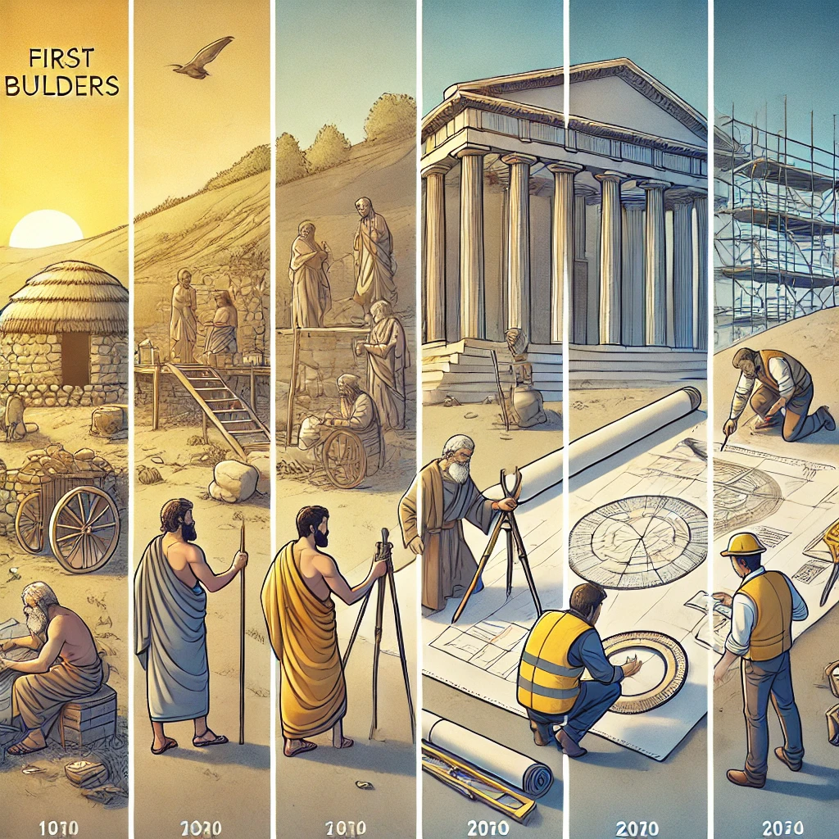

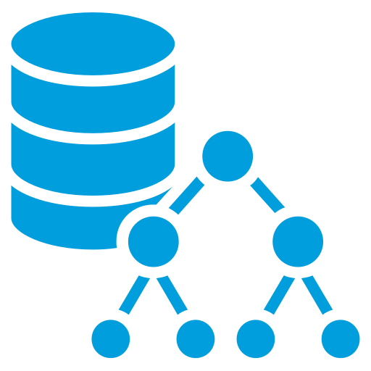

Documentation Types
C4, UML, and ADR – Different Views, One Goal
Each format tells part of the story: structure, interaction, rationale — all matter.
C4 Model
UML
ADR
Notes:
🧠 Sources of Latency
Network delay – physical distance, congestion
Backend processing – business logic, DB queries
Serialization/deserialization – converting data formats
Queueing delays – requests waiting to be served
Client-side rendering – browser-side delays (JS execution)

Slide 5
UML – Unified Modeling Language
The Classic Language for Software Structure and Behavior
📦 Component Diagram
Shows system modules and their dependencies.
🔄 Sequence Diagram
Represents interactions over time — who calls whom, and when.
🔁 Activity Diagram
Flowchart-style logic: conditions, loops, branches.
📐 Class Diagram
Describes object-oriented structure: classes, fields, methods, and relationships (inheritance, aggregation, etc.)
Notes:
🧠 Sources of Latency
Network delay – physical distance, congestion
Backend processing – business logic, DB queries
Serialization/deserialization – converting data formats
Queueing delays – requests waiting to be served
Client-side rendering – browser-side delays (JS execution)

Slide 6
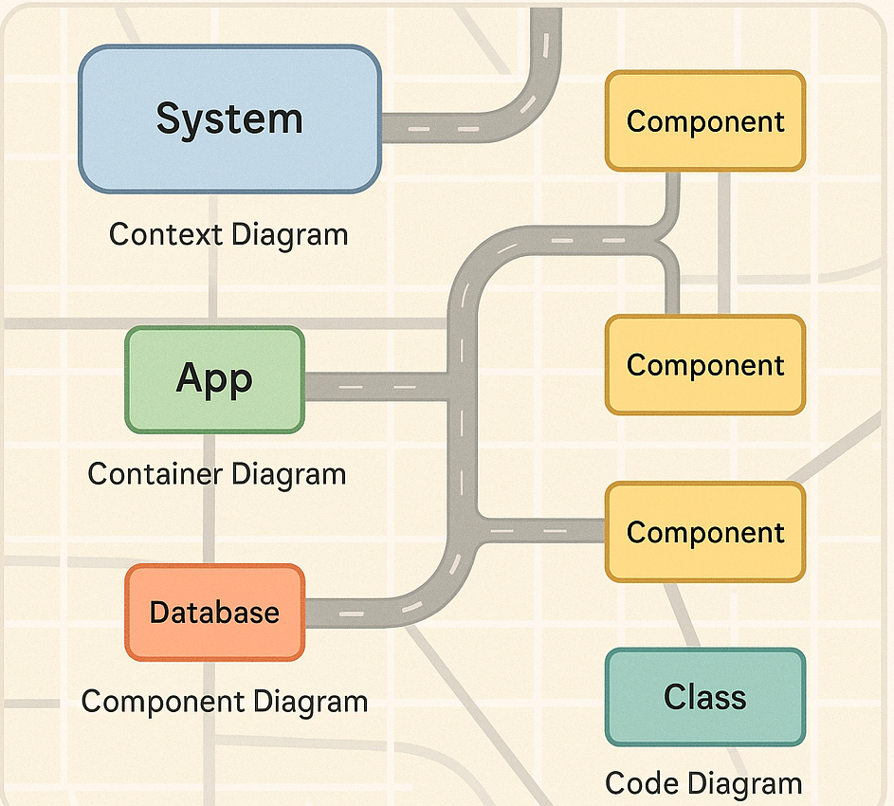
C4 Model – Visualizing Software Architecture
From High-Level Context to Detailed Components
📌 Context Diagram
🧰 Container Diagram
🔧 Component Diagram
💻 Code Diagram (optional)
Notes:
🧠 Sources of Latency
Network delay – physical distance, congestion
Backend processing – business logic, DB queries
Serialization/deserialization – converting data formats
Queueing delays – requests waiting to be served
Client-side rendering – browser-side delays (JS execution)

Slide 7

ADR – Architecture Decision Record
Documenting Design Decisions with Purpose
Keeps track of why decisions were made
Helps onboard new team members quickly
Improves collaboration and accountability
Enables evolutionary architecture
Notes:
🧠 Sources of Latency
Network delay – physical distance, congestion
Backend processing – business logic, DB queries
Serialization/deserialization – converting data formats
Queueing delays – requests waiting to be served
Client-side rendering – browser-side delays (JS execution)

Slide 8
Documentation as Code
Version, Review, and Evolve Like Your Architecture Deserves
Treating documentation like source code brings software-level discipline to architecture and design knowledge.
🗂 Versioning
👥 Collaboration & Review
🔄 Maintainability
🧪 CI Integration
📁 Single Source of Truth
🔐 Git as Source of Truth
Notes:
🧠 Sources of Latency
Network delay – physical distance, congestion
Backend processing – business logic, DB queries
Serialization/deserialization – converting data formats
Queueing delays – requests waiting to be served
Client-side rendering – browser-side delays (JS execution)

Slide 9
Markdown for Technical Documentation
Lightweight, Flexible, and Developer-Friendly
👨‍💻Developer-Friendly
💼Portable
📖Clean & Readable
📊Diagrams
📐Structured Enough
Notes:
🧠 Sources of Latency
Network delay – physical distance, congestion
Backend processing – business logic, DB queries
Serialization/deserialization – converting data formats
Queueing delays – requests waiting to be served
Client-side rendering – browser-side delays (JS execution)

Slide 10
Example: ADR in Markdown
Simple, Structured, and Versionable
# ADR 001: Database Strategy
## Status
Accepted
## Context
We need to choose a database strategy for the user profile service.
## Decision
We will use **MongoDB** for its schema flexibility and scaling features.
## Consequences
- Fast initial development
- Potential complexity in ACID transactions
- We'll need to monitor data growth and indexing
Notes:
🧠 Sources of Latency
Network delay – physical distance, congestion
Backend processing – business logic, DB queries
Serialization/deserialization – converting data formats
Queueing delays – requests waiting to be served
Client-side rendering – browser-side delays (JS execution)

Slide 11
AsciiDoc for Structured Architecture Documentation
Rich, Semantic, and Ideal for Long-Form Docs
✅Semantic Structure
✅Extensible
✅Modular & Reusable
✅Tooling Friendly
Great for Books & Docs
✅
Notes:
🧠 Sources of Latency
Network delay – physical distance, congestion
Backend processing – business logic, DB queries
Serialization/deserialization – converting data formats
Queueing delays – requests waiting to be served
Client-side rendering – browser-side delays (JS execution)

Slide 12
Example: ADR in Markdown
Simple, Structured, and Versionable
= ADR 001: Database Strategy
:status: Accepted
:toc: auto
:date: 2025-07-06
== Context
We need to choose a database strategy for the user profile service.
The system requires flexible schema, horizontal scalability, and fast iterations.
== Decision
We will use *MongoDB* for its schema flexibility and scaling features.
Future read models can be optimized separately if needed.
== Consequences
* Fast initial development
* Potential complexity in ACID transactions
* We'll need to monitor data growth and indexing
Notes:
🧠 Sources of Latency
Network delay – physical distance, congestion
Backend processing – business logic, DB queries
Serialization/deserialization – converting data formats
Queueing delays – requests waiting to be served
Client-side rendering – browser-side delays (JS execution)

Slide 13
Markdown vs AsciiDoc
Choosing the Right Tool for Architecture Documentation
Feature | Markdown | AsciiDoc
Learning Curve | ✅ Very easy | ⚠️ Moderate – more syntax to learn
Basic Syntax | ✅ Minimal | ✅ Rich and expressive
Complex Structures | ❌ Limited | ✅ Supports sections, callouts, tables
Extensibility | ⚠️ Plugins required | ✅ Native support (e.g., diagrams)
Diagrams Integration | ⚠️ Needs Mermaid plugin | ✅ Supports PlantUML, Mermaid, C4Model
Output Formats | ✅ HTML, PDF (via converters) | ✅ HTML, PDF, DocBook, EPUB
Use in Software Docs | ✅ READMEs, ADRs | ✅ Architecture, Books, API docs
Community & Tooling | ✅ Huge (GitHub, editors) | ⚠️ Smaller but growing (Antora, IDEs)
Notes:
🧠 Sources of Latency
Network delay – physical distance, congestion
Backend processing – business logic, DB queries
Serialization/deserialization – converting data formats
Queueing delays – requests waiting to be served
Client-side rendering – browser-side delays (JS execution)

Slide 14
Visualizing Architecture with PlantUML
Diagrams as Code for System and Software Design
Architecture overviews
System interaction (sequence)
Component decomposition
Deployment diagrams
Decision documentation with ADRs
@startuml mvc-simple-component
[View] --> [Controller] : user events
[Controller] --> [Model] : updates/query
[Model] --> [Controller] : result
[Controller] --> [View] : response
@enduml
Notes:
🧠 Sources of Latency
Network delay – physical distance, congestion
Backend processing – business logic, DB queries
Serialization/deserialization – converting data formats
Queueing delays – requests waiting to be served
Client-side rendering – browser-side delays (JS execution)

Slide 15
Diagramming with Mermaid
Text-based diagrams for Markdown and AsciiDoc
Supports Diagrams-as-Code, improving version control and collaboration
Compatible with both Markdown and AsciiDoc
Rendered natively on platforms like GitHub, GitLab, Obsidian, and via Kroki for AsciiDoc
Easy to learn and quick to use for many diagram types
Notes:
🧠 Sources of Latency
Network delay – physical distance, congestion
Backend processing – business logic, DB queries
Serialization/deserialization – converting data formats
Queueing delays – requests waiting to be served
Client-side rendering – browser-side delays (JS execution)

Slide 16
Visualizing Architecture with Mermaid
Diagrams as Code for System and Software Design
Architecture overviews
System interaction (sequence)
Component decomposition
Deployment diagrams
Decision documentation with ADRs
graph TD
V[👁️ View] --> C[🧭 Controller]
C --> M[🗃️ Model]
M --> C
C --> V
Notes:
🧠 Sources of Latency
Network delay – physical distance, congestion
Backend processing – business logic, DB queries
Serialization/deserialization – converting data formats
Queueing delays – requests waiting to be served
Client-side rendering – browser-side delays (JS execution)

Slide 17
Exercise: Representing a Java Server Request Flow
HTTP Java Request
Represent the flow of a request through a Java server using a sequence diagram. Use components such as:
🌐 Client (e.g., browser or mobile app)
🚪 Controller (e.g., Controller)
⚙️ Service (e.g., business logic layer)
🗄️ Repository/DAO (data access layer)
💾 Database
Notes:
🧠 Sources of Latency
Network delay – physical distance, congestion
Backend processing – business logic, DB queries
Serialization/deserialization – converting data formats
Queueing delays – requests waiting to be served
Client-side rendering – browser-side delays (JS execution)

Slide 18
Exercise: Model Credit Card Lifecycle
Credit Card Lifecycle
The card starts in the Created state.
From Created, it can become Active.
An Active card can be:
Suspended
Cancelled
A Suspended card can return to Active.
A Cancelled card is terminal (no further transitions).
Notes:
🧠 Sources of Latency
Network delay – physical distance, congestion
Backend processing – business logic, DB queries
Serialization/deserialization – converting data formats
Queueing delays – requests waiting to be served
Client-side rendering – browser-side delays (JS execution)

Slide 19
Exercise: Bank System Context
External Interaction in a Modern Banking Platform
Customer → Bank System → Payment Processor
Notes:
🧠 Sources of Latency
Network delay – physical distance, congestion
Backend processing – business logic, DB queries
Serialization/deserialization – converting data formats
Queueing delays – requests waiting to be served
Client-side rendering – browser-side delays (JS execution)

Slide 20
Structurizr
External Interaction in a Modern Banking Platform
Write architecture diagrams as code using a simple DSL
Supports C4 Model levels: Context, Container, Component, Code
Encourages evolutionary architecture — your diagrams grow with your system
Enables collaboration: share models, version control with Git
View your diagrams on the web or export them as images
Notes:
🧠 Sources of Latency
Network delay – physical distance, congestion
Backend processing – business logic, DB queries
Serialization/deserialization – converting data formats
Queueing delays – requests waiting to be served
Client-side rendering – browser-side delays (JS execution)

